Slide 1
Python Day Two -Object Reference and Dynamic Typing
POHANWU
20190131

Slide 2

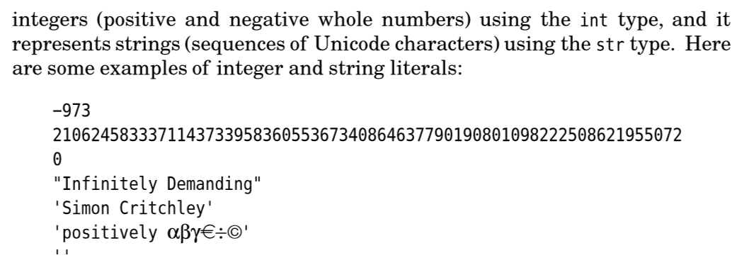
Data type: “int” “str”Page14-15

Slide 3



Access sequence “[n]” page 15

Slide 4


“kkbox”[3]=h is not allow page 15

Slide 5

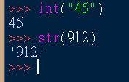


Datatype convert page15-16

Slide 6
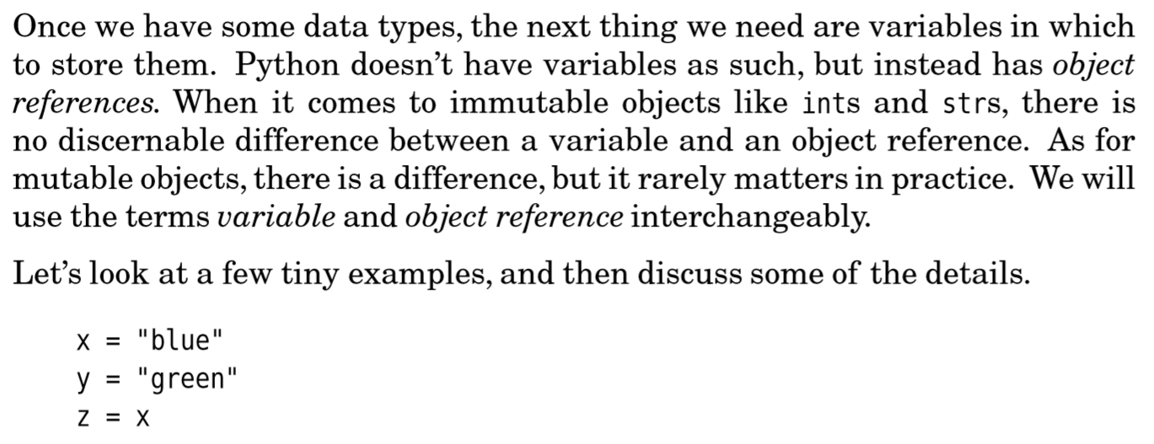
Object reference

Slide 7


Object reference

Slide 8

The = operator

Slide 9

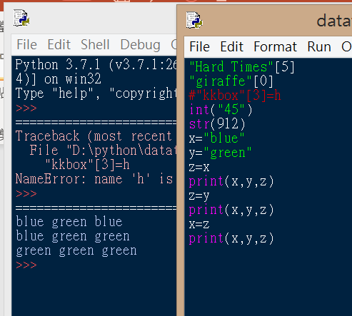

Object reference exercise

Slide 10
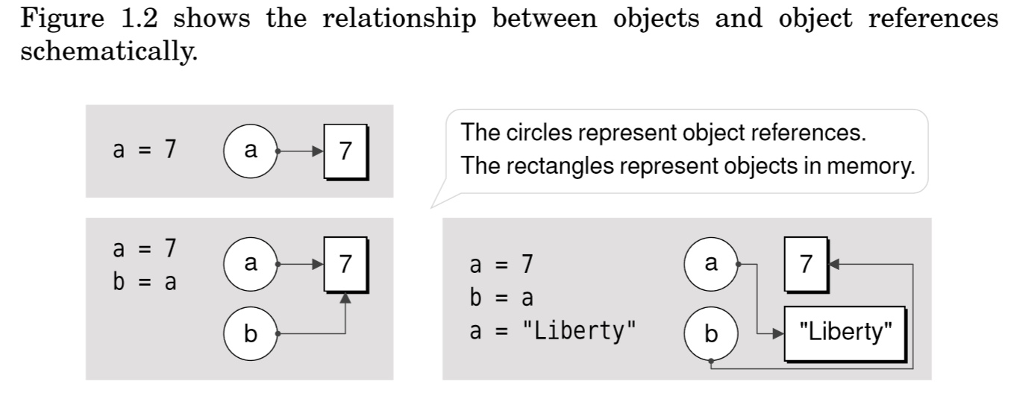
Object reference

Slide 11

Object reference restrictions

Slide 12




Dynamic typing

Slide 13

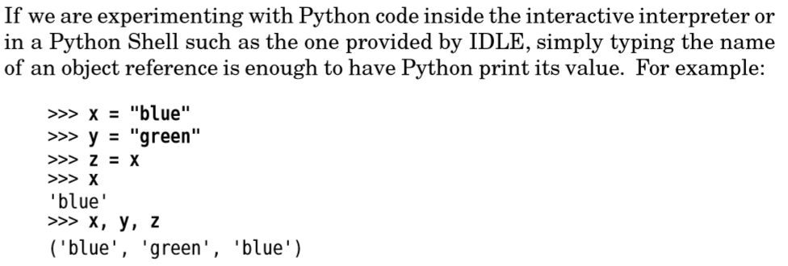
tips

